Slide 1
Intro to coding and Git
Raphael Eisenhofer
2022_03_03

Slide 2
Outline for today:
1. What is coding?
2. Why is coding useful?
3. What is Git/GitHub?
4. Getting started with Git/GitHub

Slide 3
1. What is coding?

Slide 4

Q: What is coding to you?

Slide 5
Instructions for computers
Machine code: 01010001 01100110 10100011 10011010

Slide 6
Instructions for computers
Machine code: 01010001 01100110 10100011 10011010
Human-readable programming languages (R, Python, etc.) are translated to machine code

Slide 7
Instructions for computers
Machine code: 01010001 01100110 10100011 10011010
Human-readable programming languages (R, Python, etc.) are translated to machine code
In this way, coding is a form of communication with computers!

Slide 8
2. How is coding useful?

Slide 9

What computers are good at
Processing things VERY fast (GHz = 1,000,000,000 / second)

Slide 10

What computers are good at
Processing things VERY fast (GHz = 1,000,000,000 / second)
Automation (able to perform exact tasks many times without errors)

Slide 11


What computers are good at
Processing things VERY fast (GHz = 1,000,000,000 / second)
Automation (able to perform exact tasks many times without errors)
Storing and retrieving data
>1,000 books per GB of computer storage

Slide 12
Examples of how coding can be useful
Moving/editing/renaming hundreds/thousands of files

Slide 13
Examples of how coding can be useful
Moving/editing/renaming hundreds/thousands of files
Automating workflows/analyses/repetitive tasks

Slide 14
Examples of how coding can be useful
Moving/editing/renaming hundreds/thousands of files
Automating workflows/analyses/repetitive tasks
Ensuring analyses can be reproduced by others

Slide 15
Examples of how coding can be useful
Moving/editing/renaming hundreds/thousands of files
Automating workflows/analyses/repetitive tasks
Ensuring analyses can be reproduced by others
Dealing with large datasets (or excel files!)

Slide 16
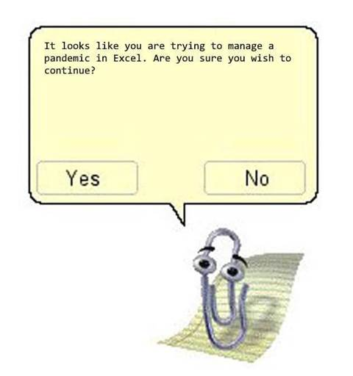
Perils of excel for large data
Study looked at >10,000 genetics papers published between 2014-2020 – found 30% of studies had data that was falsely autocorrected by excel! (https://doi.org/10.1371/journal.pcbi.1008984)

Slide 17
3. What is Git/GitHub?

Slide 18


Git and GitHub
Git is a open-source version control system
Records:
What?
When?
Why?
GitHub is a online service provider of git (+ extras)
A really good way of managing software development projects (or research projects in general!)

Slide 19
Examples:
Reproducible code for a scientific paper: https://github.com/EisenRa/2020_SHNW_Faecal_16S
Hosting/development of software: https://github.com/wwood/CoverM
Misc. projects/groups: https://github.com/EisenRa/2022_Adelaide_Code_Club

Slide 20
4. Getting started with Git/GitHub

Slide 21

The command line

Slide 22
Manoeuvring around the command line
pwd (‘path to working directory’ prints where you are o the computer)
ls (lists the contents of the directory/folder you’re in)
cd (‘change directory’ changes your current directory

Slide 23
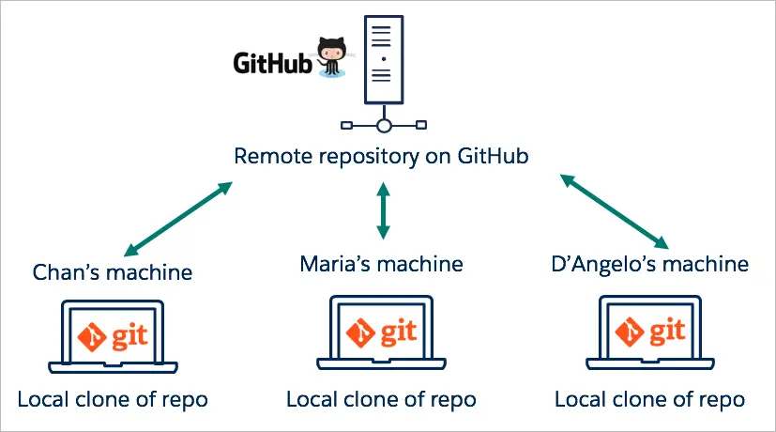
Repositories
A repository is where a given project/software is stored (analogous to a folder)

Slide 24
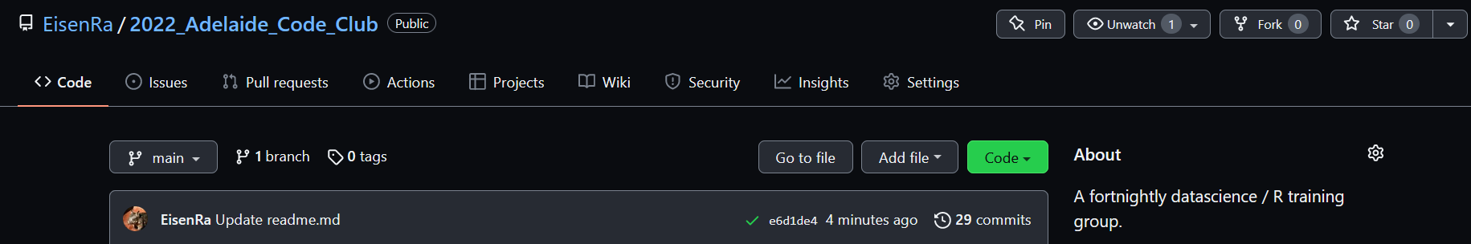
Cloning a repository
To clone it, type the following: git clone https://github.com/user/repositoryname.git

Slide 25
Creating your own repositories
Plenty of great guides out there, so if you’re interested, follow one of these:
From scratch: https://docs.github.com/en/get-started/quickstart/create-a-repo
Already have files/folders/project that you want to push to GitHub remote: https://docs.github.com/en/get-started/importing-your-projects-to-github/importing-source-code-to-github/adding-an-existing-project-to-github-using-the-command-line

Slide 26
Summary
Knowing the basics of coding can save you a lot of time/pain
Git/GitHub are fantastic tools for managing projects/research
Collaborating with others
Ensuring reproducibility (yourself and for others)

